Slide 1
Tries
By Ralph McDougall
IOI Camp 3
4 March 2017

Slide 2
What is a trie?
A trie is sometimes called a digital tree, radix tree or prefix tree
Trie is pronounced either “tree” or “try”, depending on who you ask
A trie is a data structure that stores words from a dictionary
It allows O(L) insertion where L is the length of the word being added
It allows O(L) existence detection where L is the length of the word being checked for
Since it stores prefixes, it allows us to find all words in a dictionary with a certain prefix

Slide 3
Implementation
To implement a trie, just like with a tree, we need some nodes
Each node stores an array containing all of its children and whether or not it is an endpoint.
We also need a root node which acts as the start point for the search and insert algorithms.

Slide 4
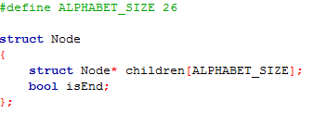
Implementation
That’s all there is to it!

Slide 5
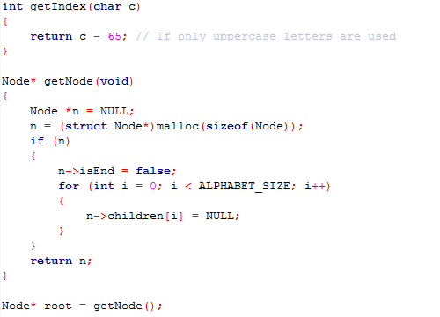
Some important things to include

Slide 6
Insertion
We start at the root vertex
We go to the child vertex corresponding to the next character of the word that we are inserting
If that node does not exist, we add a new node there and go to it
We keep doing this until we have checked all of the characters
We mark the last vertex visited as an end node for a word.
Notice that adding a new node and moving to a new node takes O(1) and checking each character takes O(L)
Thus insertion is O(L)

Slide 7
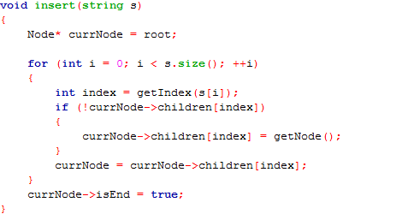
Insertion

Slide 8
Search
We start at the root vertex
If the next character isn’t present, the word isn’t present, so we can return false
We move to the next character and repeat this until we have checked all of the characters
We return true if the last node is an end node and it is valid
Checking if a character is present takes O(1) and checking each character takes O(L)
Thus, searching takes O(L)

Slide 9
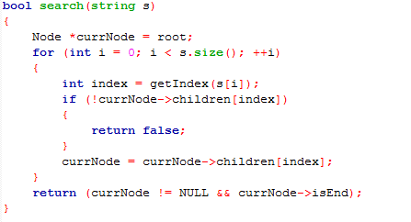
Search

Slide 10
Analysis
Time complexity:
Insertion: O(L)
Search: O(L)
Space complexity: O(NL)

Slide 11
Example Question
You are given a dictionary of N words and word W. You want to find the “closest match” to W in the dictionary. The “closest match” is the word that differs from W in the least number of characters.
(“car” is closer to “cat” than “bat” is to “cat”)

Slide 12
Bruce Force Solution
Generate each possible word that can be obtained from W by changing a few characters. This takes exponential time, which is terrible!

Slide 13
Trie Solution
We create a prefix tree of all of the words in the dictionary. We now do a Dijkstra on the tree keeping track of how many characters it differs by at each stage.
We can calculate the answer much faster using this.

Slide 14
Trie Solution
We can construct the prefix tree in O(LN) where L is the length of the longest word. We can check if a word is in the prefix tree in O(LK). Thus we can complete the problem in O(L²NK). Note that this is the worst case scenario.

